Slide 1
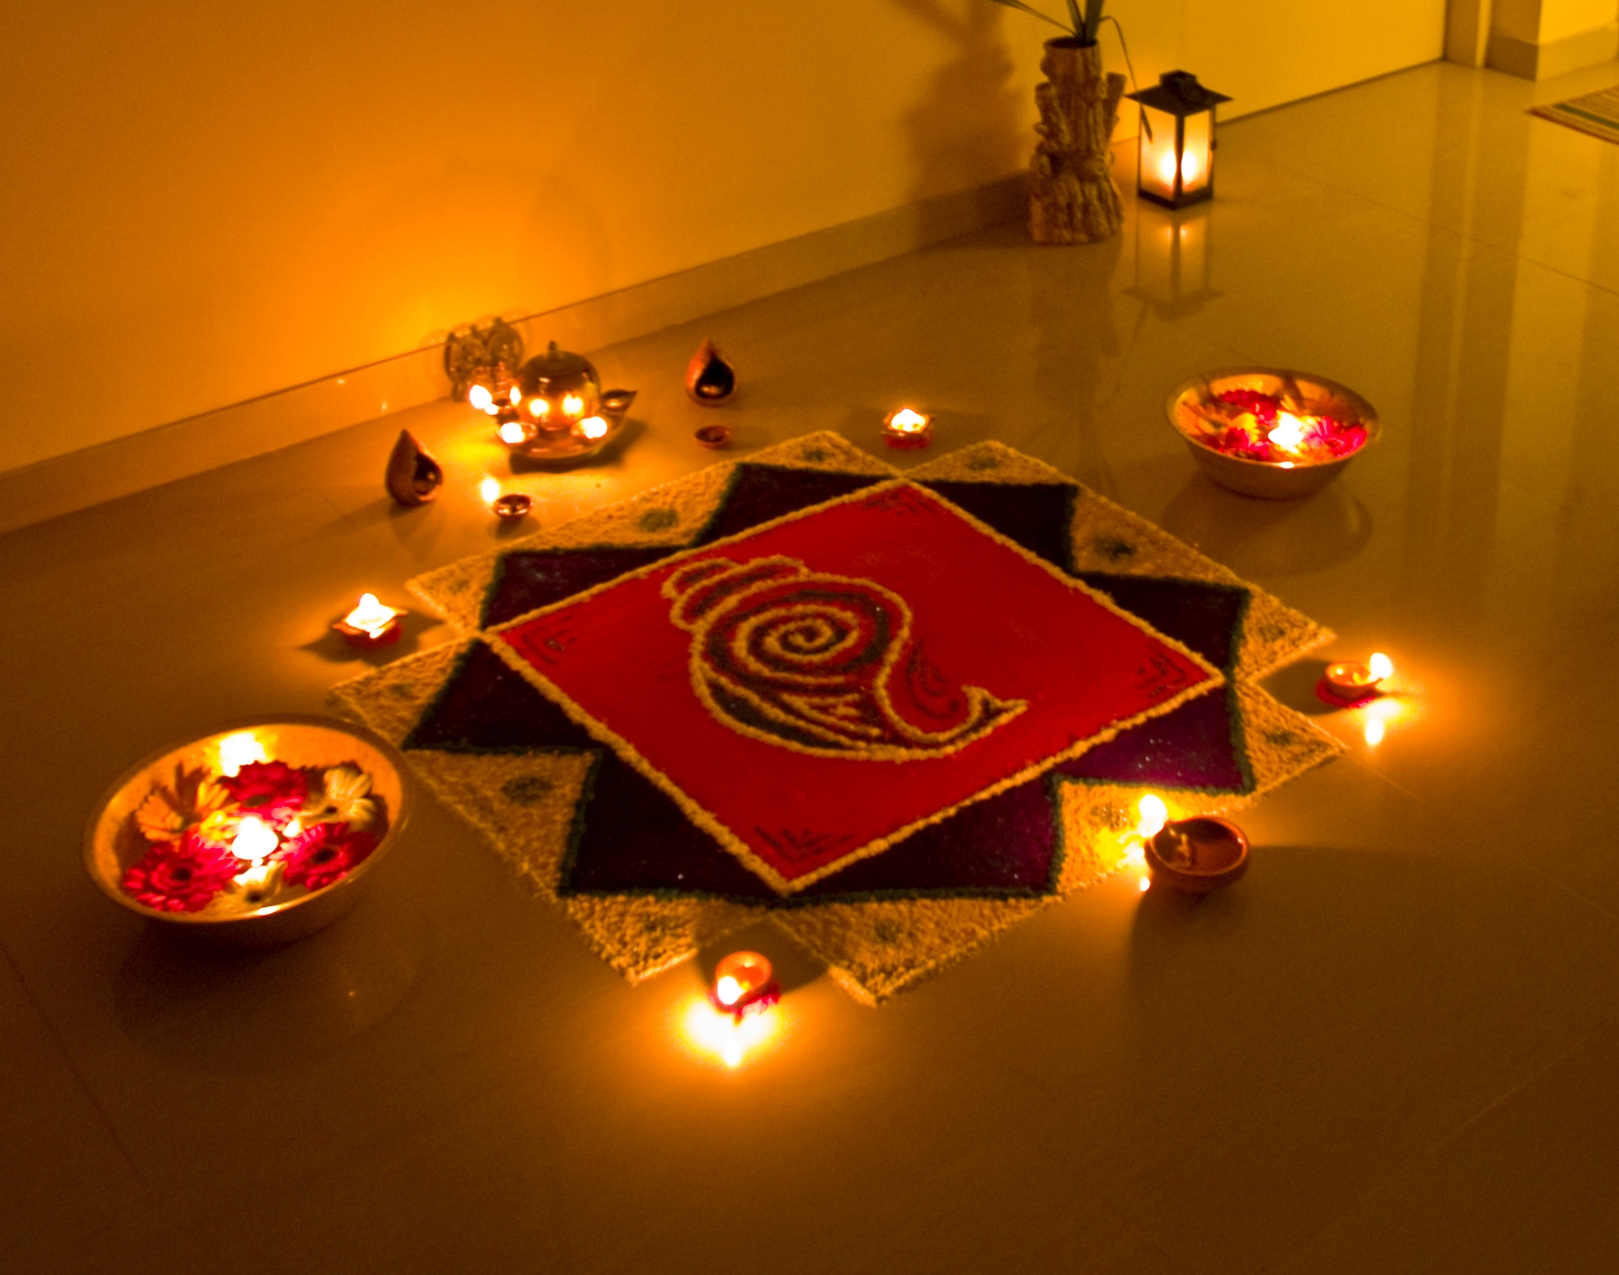
Diwali
Student Health & Human Services
Office of Human Relations, Diversity & Equity
June 2022

Slide 2
Would you rather...
Go to the past and meet your ancestors
Go to the future and meet your great, great grandchildren

Slide 3
Objective
Learn about what Diwali is

Slide 4
What is Diwali?
a festival of lights and one of the major festivals celebrated mainly by Hindus, Jains, and Sikhs.
usually lasts five days and celebrated during the Hindu Lunisolar month Kartika (between mid-October and mid-November).
One of the most popular festivals of Hinduism, Diwali symbolizes the spiritual "victory of light over darkness, good over evil, and knowledge over ignorance".

Slide 5
The 5 Days
The first day of the festival when celebrants prepare by cleaning their homes and making decorations on the floor, such as rangolis.
The second day is Naraka Chaturdashi.
The third day is the day of Lakshmi Puja and the darkest night of the traditional month.
In some parts of India, the day after Lakshmi Puja is marked with the Govardhan Puja and Balipratipada (Padwa).
Some Hindu communities mark the last day as Bhai Dooj or the regional equivalent, which is dedicated to the bond between sister and brother, while other Hindu and Sikh craftsmen communities mark this day as Vishwakarma Puja and observe it by performing maintenance in their work-spaces and offering prayers.

Slide 6
The Festival
During Diwali, people wear their finest clothes
Illuminate the interior and exterior of their homes with the diyas and rangolis
They perform lakshmi puja (worship ceremonies of Lakshmi – the goddess of prosperity and wealth
Light fireworks
Partake in family feasts
Mithai (sweets) and gifts are shared

Slide 7
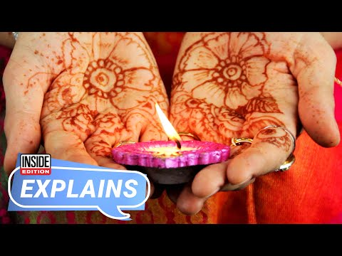
What is Diwali?
Notes:
Play the video for the students: 4:03
What Is Diwali and How Is It Celebrated? - YouTube

Slide 8
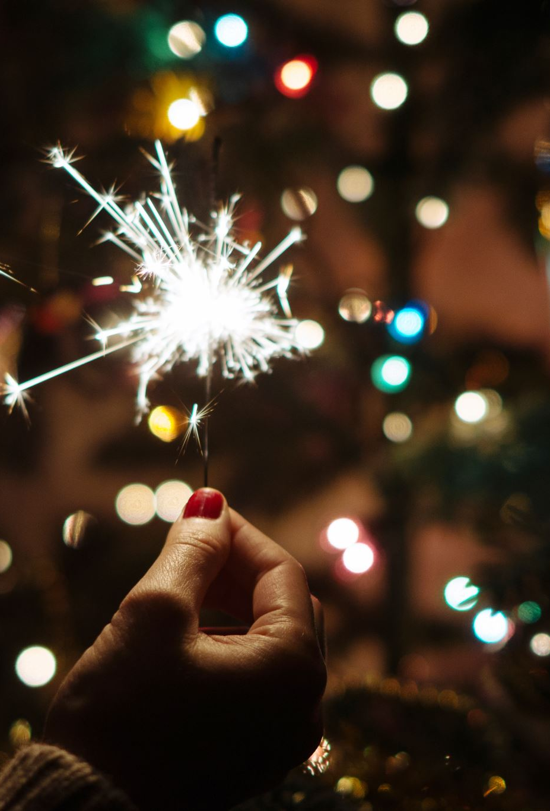
Time to Share
Are there any other events in your culture that you celebrate? If so, what?
Is this like any other cultural event you've celebrated or heard of?

Slide 9


Which is better?

Slide 10
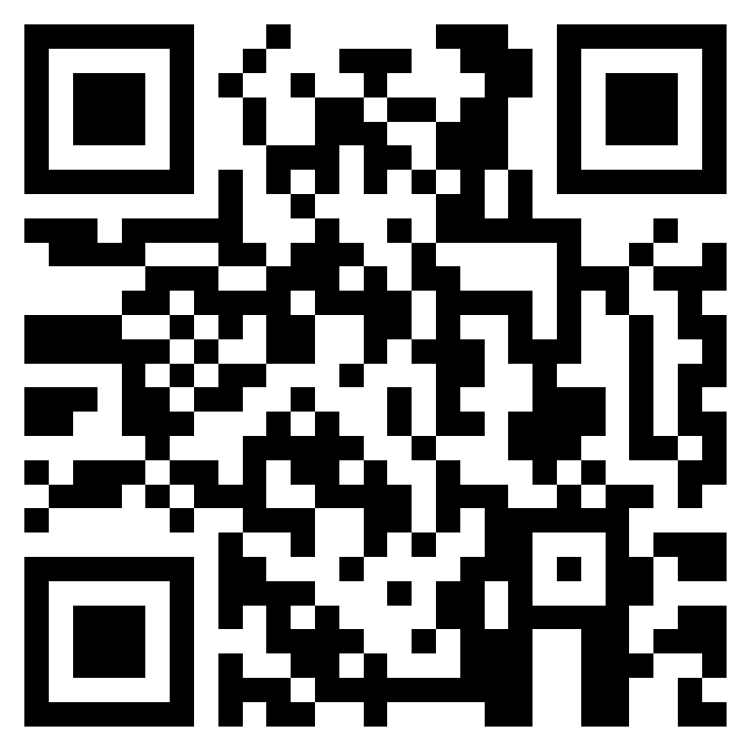
Teacher Feedback Survey
Notes:
Teacher, please scan the QR code or click the link below to complete the feedback survey:
https://forms.office.com/r/i9UqyyxzTT

Slide 11

Human Relations, Diversity & Equity

